Slide 1
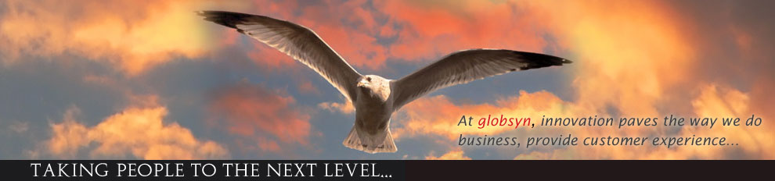

GOOD MORNING ☺

Slide 2

BUS RESERVATION SYSTEM
GROUP MEMBERS:-
AGNIP KARMAKAR,JALPAIGURI GOVT ENGINEERING COLLEGE
ARITRA DUTTA,JALPAIGURI GOVT ENGINEERING COLLEGE
ANINDYA PANJA,JALPAIGURI GOVT ENGINEERNG COLLEGE
ANKIT KUMAR,TECHNO INDIA SALT LAKE
ABHIK PAL,BPPIMT

Slide 3
INTRODUCTION
-Ease to book tickets.
-More flexibility.
-Different options availability.
-User friendly.

Slide 4
OBJECTIVE AND PURPOSE
The objective was to let customer book ticket easily and when they need it.
-Management work simple.
-Ease of communication.
-Ease of details.
-It helps to acquire customer details.

Slide 5
-Less harassment.
-Better service.
-Fulfilling demands of customer.

Slide 6
PROBLEM DEFINITION
-System used is an internal system.
-Customer needs to go to the counter.
-Customer may need to queue up long.
-Teli booking not available.

Slide 7

SOFTWARE AND HARDWARE USED
OPERATING SYSTEM : Windows 7(min)
LANGUAGE USED : java1.8
Ide used : eclipse luna
Computer processor : pentium 4(min)
Hard disk : 50gb
Ram : 512mb(min or more)

Slide 8
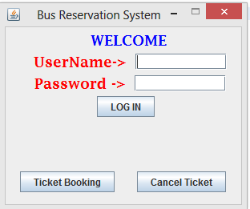
PROJECT DESCRIPTION AND FLOW LOGIC
ADMIN LOGIN AND CUSTOMER TICKET BOOKING/CANCEL PAGE:-

Slide 9
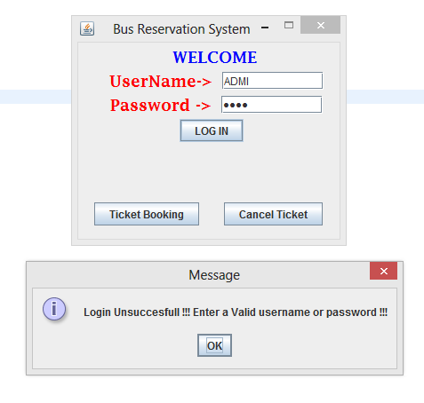
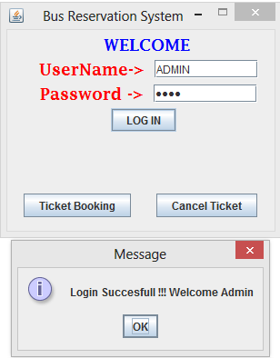
ADMIN LOGIN
IF USERNAME OR PASSWORD IS INCORRECT
IF BOTH USERNAME AND PASSWORD IS CORRECT

Slide 10
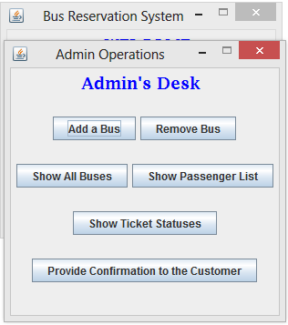
AFTER ADMIN LOGIN
ADMIN OPERATIONS PAGE

Slide 11
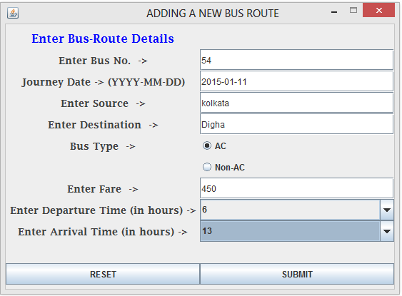
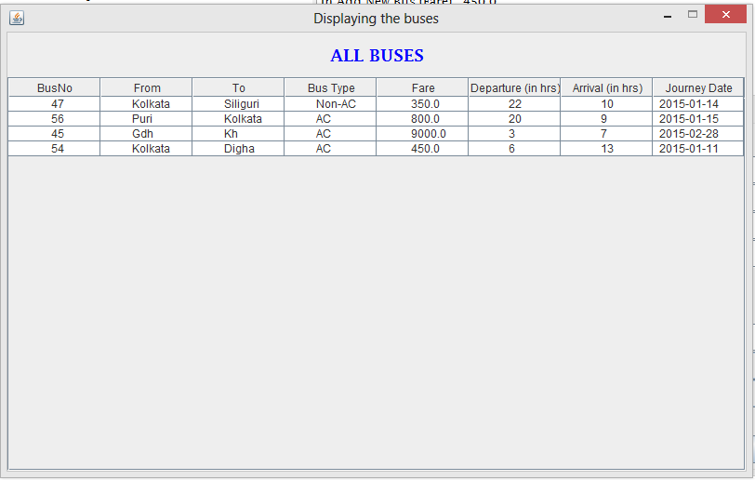
AFTER CLICKING ON ADD A BUS
FILLING UP THE BUS DETAILS
NEW BUSES HAS BEEN ADDED

Slide 12
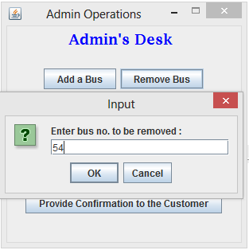
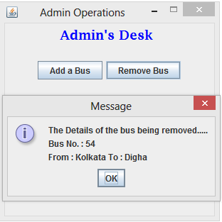
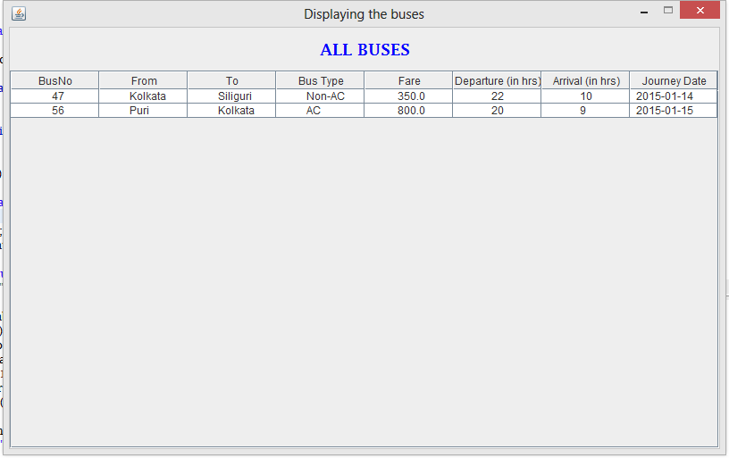
AFTER CLICKING ON REMOVE BUS
PROVIDING THE BUS NO.
GETTING BUS DETAILS TO BE REMOVED
BUS REMOVED

Slide 13
AFTER CLICKING ON SHOW ALL BUSES

Slide 14
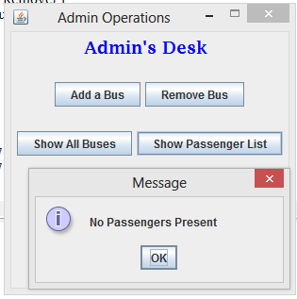
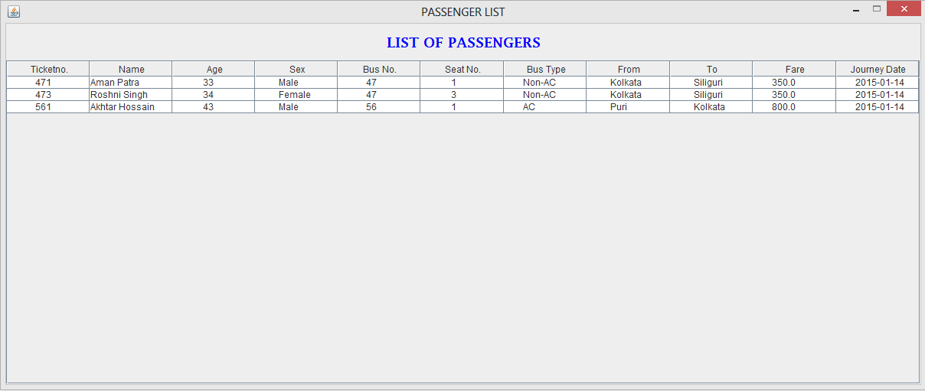
AFTER CLICKING ON SHOW PASSENGER LIST
IF NO PASSENGER IS PRESENT
IF PASSENGER IS PRESENT

Slide 15
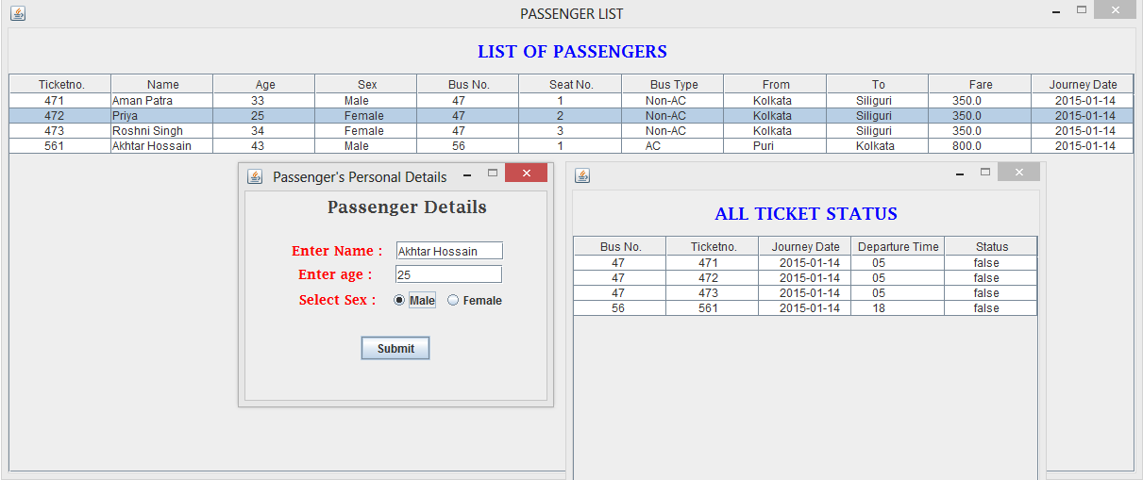
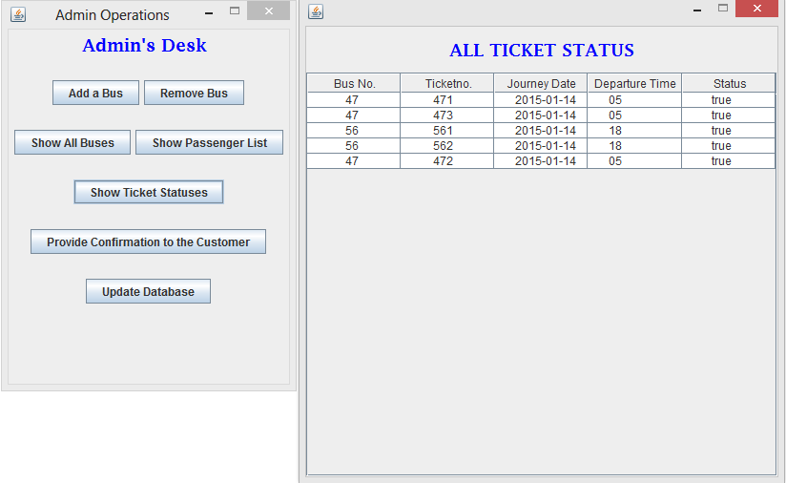
AFTER CLICKING ON CHECK TICKET STATUS
TICKET STATUS FALSE TILL ADMIN PROVIDES CONFIRMATION
TICKET STATUS TRUE AFTER ADMIN PROVIDES CONFIRMATION

Slide 16
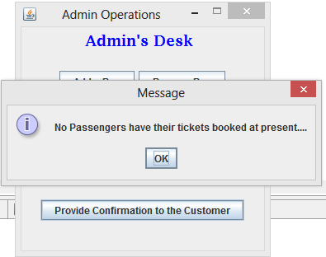
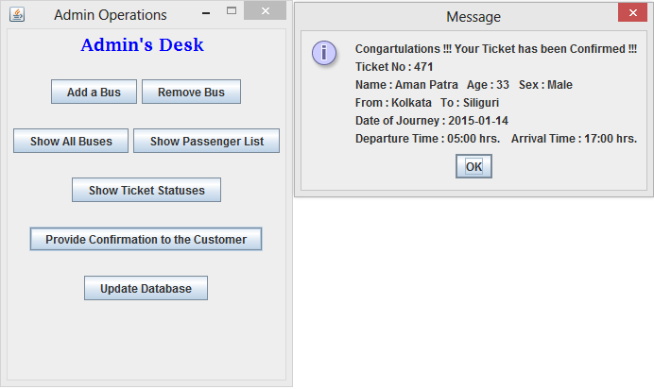
AFTER CLICKING ON PROVIDE CONFIRMATION TO CUSTOMER
TICKET CONFIRMED
IF THERE IS NO PASSENGER TO BE CONFIRMED

Slide 17
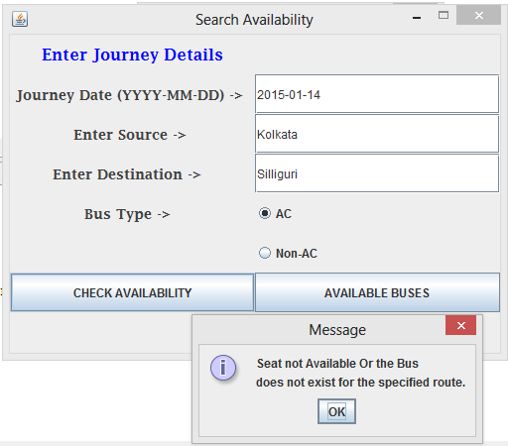
AFTER CLICKING ON TICKET BOOKING
IF DETAILS PROVIDED IS INCORRECT

Slide 18
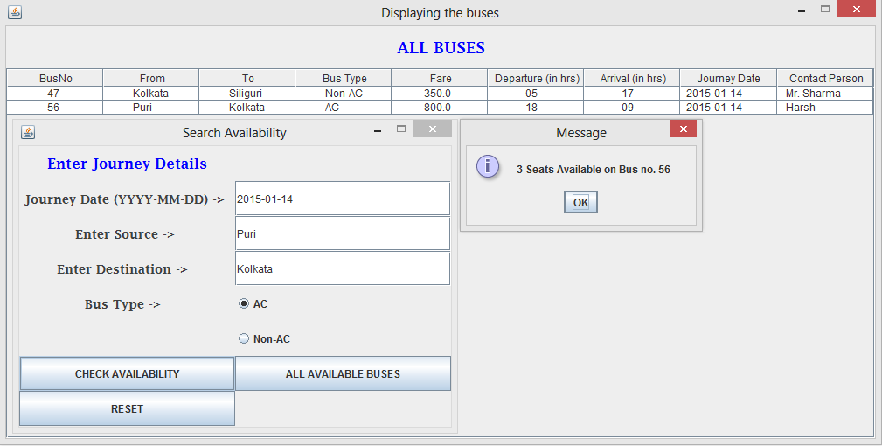
AVAILABLE BUSES
IF DETAILS PROVIDED IS CORRECT

Slide 19
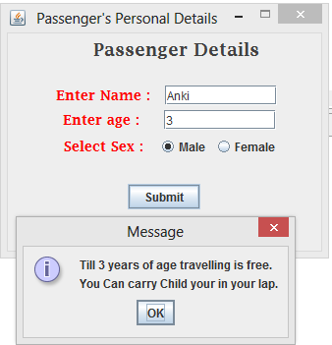
AFTER CLICKING ON TICKET BOOKING
PROVIDING CUSTOMER DETAILS
IF DETAILS PROVIDED IS CORRECT
IF AGE MORE OR LESS THAN 3 YEARS

Slide 20
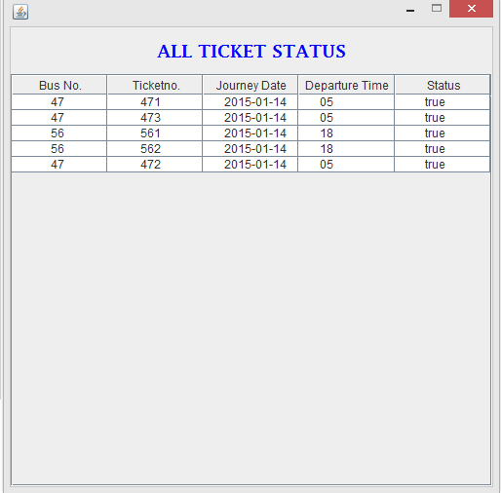
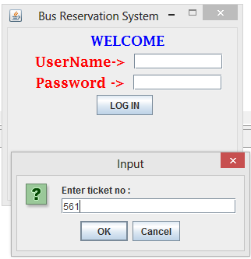
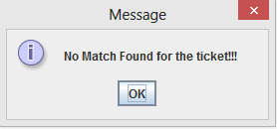
AFTER CLICKING ON CANCEL TICKET
PROVIDING TICKET DETAILS INCORRECT
TICKET DETAILS

Slide 21
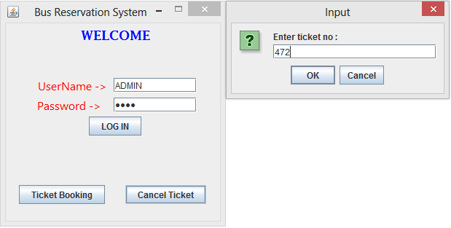
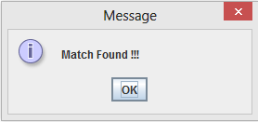
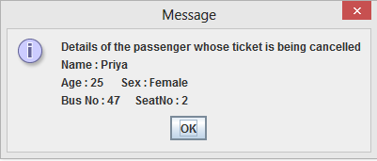
IF DETAILS PROVIDED IS CORRECT

Slide 22
FUTURE SCOPE
-Vast scope in future.
-Implemented in internet
-Updated in future
-flexibility in term of expansion

Slide 23
CONCLUSION
As we told that further more implementation needs to be done for the improvement of our project which is in process and we hope that we will get to our aim as soon as possible. We are hoping to make this project user friendly so that booking a bus ticket would not be that difficult for passenger.
A special thanks to our mentor for guidance and blessing without which the project would not have been presented.

Slide 24


